Slide 1
Reliable Frontends
A Journey into JavaScript Frontend Testing

Slide 2
The Focus
For JavaScript applications
Writing tests for Frontend logic
Unit/Integration tests

Slide 3
What? & How ?
What should be tested in frontends ?
How they should be tested ?

Slide 4
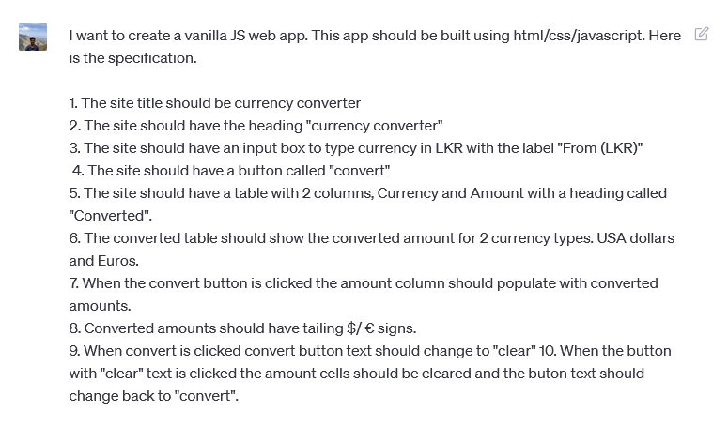
I asked Chat GPT
Build a currency converter.

Slide 5
What?
Should have title “Currency Converter”
Should have heading “Currency Converter”
Should have a label “From (LKR)
Should convert when convert button clicked.
Button text should be clear when convert is clicked
Converted amounts should have tailing $/€‎ signs

Slide 6
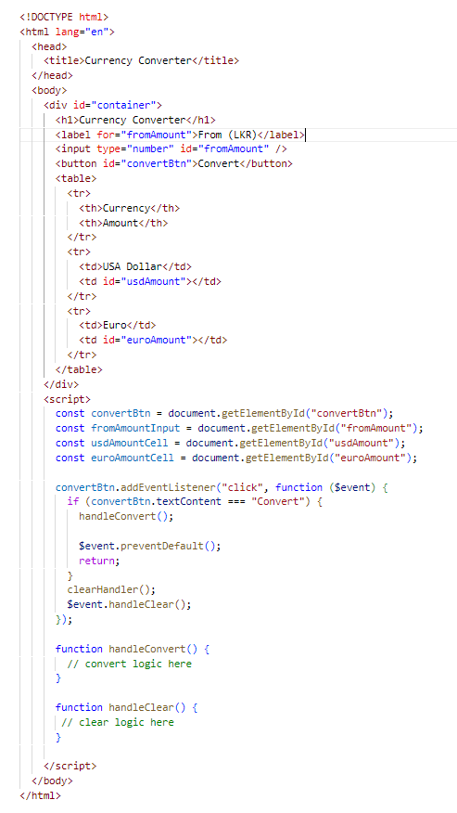
How?
Should have title “Currency Converter”
Check document title is “Currency Converter”
Should have heading “Currency Converter”
Check document has a h1 with textContent ““Currency Converter”
Should have a label “From (LKR)”
Check the label text for input is “From (LKR)”
Should convert when convert button clicked.
Check table amount cell values are correct
Button text should be clear when convert is clicked
Check the button text after convert button is clicked
Converted amounts should have tailing $/€‎ signs
Check amount columns has currency signs
Chat GPT’s implementation

Slide 7
Buzz words
Test framework
Assertion Library
Test Runner
Test Environment
Fixtures and testcases

Slide 8
BDD

Slide 9
Stub Types

Slide 10
Demos
My Test framework – non-UI/UI
Using Test framework
Using Test Runner
Testing in Meat frameworks

Slide 11
Demo 1
My Test framework – non-UI/UI

Slide 12
Demo 2
Using Test framework

Slide 13
Demo 3
Using Test Runner

Slide 14
Demo 4
Testing in Meat frameworks

